Slide 1
Bayesian Statistics
Bayesian Prediction
Brani Vidakovic
Professor
ISyE Georgia Tech

Slide 2
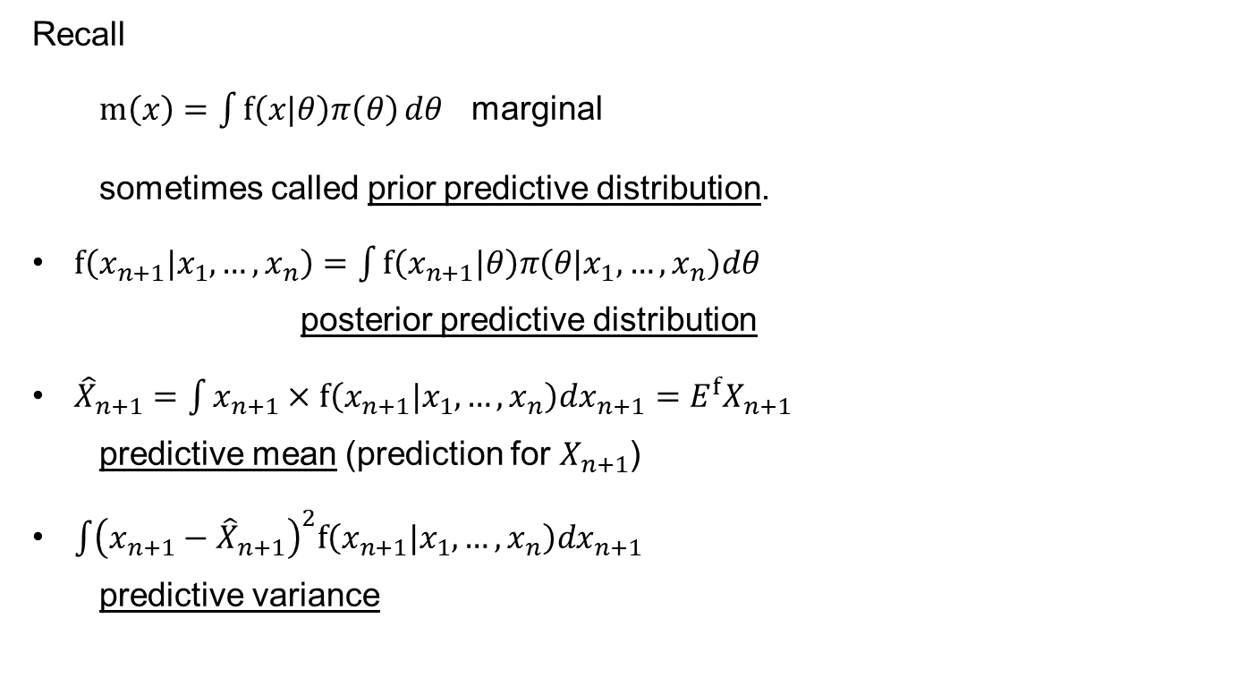
Bayesian Prediction
Recall
$m\left(x\right)=\int{f\left(x|θ\right)π\left(θ\right)}dθ$ marginal
sometimes called prior predictive distribution.
$f\left(x_{n+1}|x_{1},…,x_{n}\right)=\int{f\left(x_{n+1}|θ\right)π\left(θ|x_{1},…,x_{n}\right)dθ}$
posterior predictive distribution
${\hat{X}}_{n+1}=\int{x_{n+1}×f\left(x_{n+1}|x_{1},…,x_{n}\right)dx_{n+1}=E^{f}X_{n+1}}$
predictive mean (prediction for $X_{n+1}$)
$\int{{\left(x_{n+1}−{\hat{X}}_{n+1}\right)}^{2}f\left(x_{n+1}|x_{1},…,x_{n}\right)dx_{n+1}}$
predictive variance

Slide 3
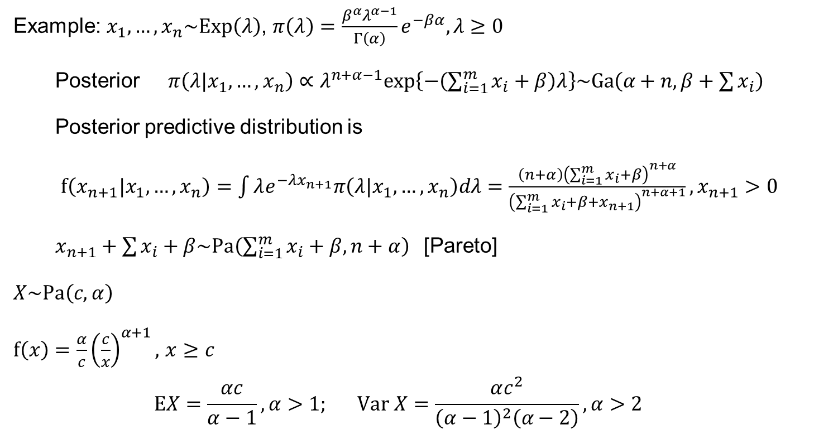
Example: $x_{1},…,x_{n}\sim Exp\left(λ\right)$, $π\left(λ\right)=\frac{β^{α}λ^{α−1}}{Γ\left(α\right)}e^{−βα}, λ≥0$
Posterior $π\left(λ|x_{1},…,x_{n}\right)∝λ^{n+α−1}exp\left\{−\left(\sum_{i=1}^{m}{x_{i}}+β\right)λ\right\}\sim Ga\left(α+n,β+\sum{x_{i}}\right)$
Posterior predictive distribution is
$f\left(x_{n+1}|x_{1},…,x_{n}\right)=\int{λe^{−λx_{n+1}}π\left(λ|x_{1},…,x_{n}\right)dλ}=\frac{\left(n+α\right){\left(\sum_{i=1}^{m}{x_{i}}+β\right)}^{n+α}}{{\left(\sum_{i=1}^{m}{x_{i}}+β+x_{n+1}\right)}^{n+α+1}}, x_{n+1}>0$
$x_{n+1}+\sum{x_{i}+β\sim Pa\left(\sum_{i=1}^{m}{x_{i}}+β,n+α\right)}$[Pareto]
$X\sim Pa\left(c,α\right)$
$f\left(x\right)=\frac{α}{c}{\left(\frac{c}{x}\right)}^{α+1},$ $x≥c$
$$EX=\frac{αc}{α−1}, α>1; Var X=\frac{αc^{2}}{{\left(α−1\right)}^{2}\left(α−2\right)}, α>2$$

Slide 4
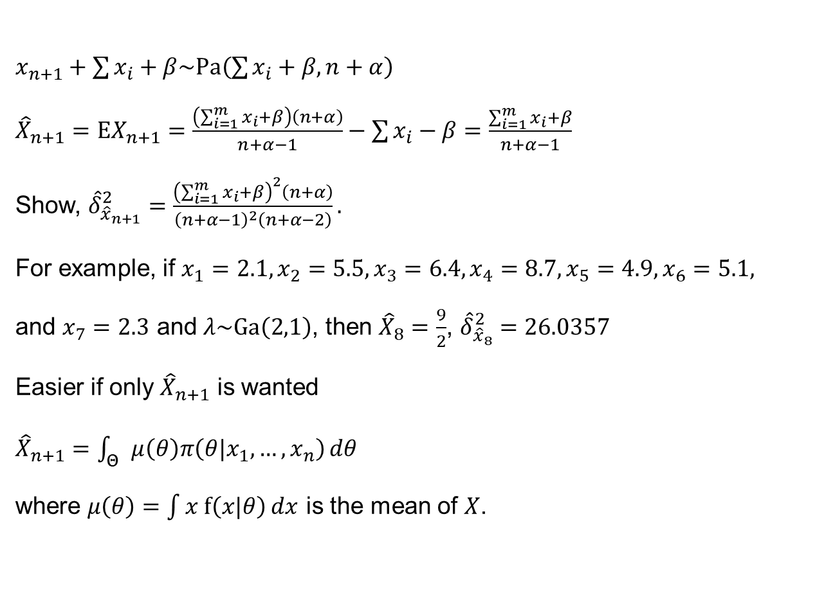
$x_{n+1}+\sum{x_{i}+β\sim Pa\left(\sum{x_{i}}+β,n+α\right)}$
${\hat{X}}_{n+1}=EX_{n+1}=\frac{\left(\sum_{i=1}^{m}{x_{i}}+β\right)\left(n+α\right)}{n+α−1}−\sum{x_{i}}−β=\frac{\sum_{i=1}^{m}{x_{i}}+β}{n+α−1}$
Show, ${\hat{δ}}_{{\hat{x}}_{n+1}}^{2}=\frac{{\left(\sum_{i=1}^{m}{x_{i}}+β\right)}^{2}\left(n+α\right)}{{\left(n+α−1\right)}^{2}\left(n+α−2\right)}.$
For example, if $x_{1}=2.1, x_{2}=5.5, x_{3}=6.4, x_{4}=8.7, x_{5}=4.9, x_{6}=5.1,$
and $x_{7}=2.3$ and $λ\sim Ga\left(2,1\right)$, then ${\hat{X}}_{8}=\frac{9}{2}$, ${\hat{δ}}_{{\hat{x}}_{8}}^{2}=26.0357$
Easier if only ${\hat{X}}_{n+1}$ is wanted
${\hat{X}}_{n+1}=\int_{Θ}{μ\left(θ\right)π\left(θ|x_{1},…,x_{n}\right)}dθ$
where $μ\left(θ\right)=\int{x f\left(x|θ\right)}dx$ is the mean of $X$.

